Slide 1
Engineering Economics
Laxman Baral
13 years in PEC
Bachelor
Master

Slide 2
60% numerical and 40% theory
10 Chapters new course, Civil forth and computer 7th
Basics of Engineering Economics
Cost concept and analysis
Interest and time value of money
Basic methodologies of engineering economic studies
Comparative analysis of alternatives
Replacement Analysis
Risk analysis
Depreciation and taxes
Capital Budgeting
Inflation

Slide 3
Chapter one: Basic Engineering Economics
Definition of Economics and principles of economics
Introduction to demand, supply, production and utility
Definition of Engineering Economics, Principles of Engineering Economics and its application
Terminologies used in engineering economics

Slide 4
Meaning of Economics
Simply economic means the science of wealth.
It is the study of how individuals and societies choose to utilize scarce resources to satisfy unlimited human wants. To produce goods and services to satisfy human wants, we need various resources like manpower, money, materials and machineries . All these resources are said to be s scarce because their supply is limited in terms of their demand. Scarcity and choices are the fundamental concepts of economic.

Slide 5
Different economists have defined economics in their own words. There is no consensus among the economists about a precise definition of economics. Therefore, it is said that whenever six economists are gathered, there are seven options. A student of economics also must know the definition of economics.
Adam Smith "Economics as a Science of Wealth"
Alfred Marshall "Economics as Science of Material Welfare"
Lionel Robbins "Economics as a Science of Scarcity and Choice”

Slide 6
Economics is the study of scarcity and how it affects the use of resources, the production of goods and services, the growth of production and many other important and complicated issues that affect society.
Economics is the study of how things are made, moved around, and used. It looks at how people, businesses, governments, and countries choose to use their resources. Economics is the study of how work and business are run. Since there are many ways to use human and other resources, it is the job of economics to figure out which ways produce the best results.

Slide 7
Economics is a social science that focuses on the production, distribution, and consumption of goods and services, and analyzes the choices that individuals, businesses, governments, and nations make to allocate resources.
Economics is the study of how people allocate scarce resources for production, distribution, and consumption, both individually and collectively.
The two branches of economics are microeconomics and macroeconomics.
Economics focuses on efficiency in production and exchange.

Slide 8
In fact, economics is a social science that studies the economic problems of a society. It also analyses the process through which the society manages it scarce resources for their proper allocation in alternative lines of production. Thus, economic studies the relationship between scarce resources and their various alternative uses which complete for those resources. Thus, it is concerned with the economic activities in a society.

Slide 9
Concept of microeconomics and macroeconomics
There are several branches of economics. Of these, two are the most important. These are microeconomics and macroeconomics. Both of these terms have been derived from Greek words micros and macros meaning small and big respectively. From the meaning, it is clear that microeconomics deals with the individual economics units and macroeconomics deals with the economy as a whole.

Slide 10
Microeconomics
Microeconomics is defined as the branch of economics which deals with the individual parts of an economy. In other words, it is the part of economic analysis which is concerned with the behavior individual units, consumers, households and firms. It examines how consumers choose between goods and services, how workers choose between jobs and business firms decide what to produce, how to produce and for whom to produce. Microeconomics is the study of particular firms, particular households, individual prices, wages, incomes, individual firms, particular commodities etc.

Slide 11
It is the study of how households and firms make decisions and how they interact in markets. Microeconomics is the branch of economics which deals with the decision making of individual units in an economy. It studies individual units of the economy than the economy as a whole. The main objective of macroeconomics is the study of price determination in the market. Therefore, it is also called price theory. The scope of microeconomics includes the topics like consumption, production, exchange, distribution and welfare economics.

Slide 12
Macroeconomics: Macroeconomics is defined as the branch of economics which deals with the economy as a whole. In other words, macroeconomics is the study of very large, economy wide aggregate variable like national income, money, unemployment, economic growth, etc. Therefore, it is also known as aggregative economics. It examines how resources are allocated at the economic system as a whole.

Slide 13
3 major definition of economics
Definition - 1 The earliest definition of economics was in terms of wealth. In 1776, Adam Smith (Scottish philosopher and economist), the father of economics and leader of classical economists defined "Economics is the science of wealth." According to him, wealth is everything that means wealth is end all i.e. man of wealth.

Slide 14
Definition - 2 Alfred Marshall (British economists), a leader of neo–classical economists focused that wealth is not end all but it is only a means to an end, the end begins from the promotion of human welfare. In 1890, Marshall defined "Economics is on the one side, a study of wealth and on the other more important side is a part of the study of man." So according to him, economics is concerned with human welfare that means man is primary importance and wealth is only secondary importance.

Slide 15
Definition - 3 Lionel Robbins (British economist) has provided a new definition of economics in 1932. According to him "Economics is the science which studies human behavior as a relationship between ends and scarce means which have alternative uses." Hence, economics is the science of scarcity and choice, and it studies how the scarce resources are allocated among different engines.

Slide 16
Fundamental Principles of Economics
Economics deals with people and reflection of how they interact with each other in making decisions regarding their lives. We study economics by observing the principles of decision making of the individuals who make up the economy, how they interact with one another and how the economy works as a whole.

Slide 17
People Make Trade-offs
A trade-off refers to the idea that choosing one thing means giving up something else. Whenever you make a choice, you are facing a trade-off because resources (like time, money, or labor) are limited.
Trade-of f means balancing two things that we need or want but which are opposite to each other. In our real life we always face trade-off while making decision about something. It is because to get one thing that we like, we usually have to give up another thing that we like. So, making decisions requires trading off one goal against another.
Example: If a government spends more on healthcare, it might have to spend less on education. That’s a trade-off.

Slide 18
Rational People Think at the Margin
This is a key principle in economics, which states that rational decision-makers evaluate the costs and benefits of small (incremental) changes rather than thinking in absolute terms.
In economics it is assumed that people are rational and rational people make the best decisions by thinking at the margin (edge) or comparing additional cost for extra benefits.
"Margin" refers to the additional (extra) unit of something.
The principle "Rational people think at the margin" is a key concept in economics, particularly in microeconomics. It means that rational decision-makers evaluate the additional (marginal) benefits and costs of a decision, rather than considering the total or average effects.

Slide 19
In economics, rational people (or "rational agents") are individuals or entities that make decisions by systematically weighing costs and benefits to maximize their utility (satisfaction, profit, or desired outcome).

Slide 20
People Respond to Incentive / benefit cost
Incentive means something that encourages people to do something. People make decisions by comparing costs and benefits, their behavior may change when the costs or benefits change. That is, people respond to incentives.
When the price of an apple rises, for instance, people decide to eat more pears and fewer apples, because the cost of buying an apple is higher. At the same time, apple producers decide to hire more workers and harvest more apples, because the benefit of selling an apple is also higher. Thus, people respond to incentives.

Slide 21
Trade Can Make Everyone Better Off
Either we talk about individuals, society or countries, trade can make everyone better off. If there were no trade, we would make everything that we need by ourselves. Therefore, trade is the one that can make everyone better off. Trade allows each person to specialize in the activities he or she does best, whether it is farming, sewing, or home building. By trading with others, people can buy a greater variety of goods and services at lower cost.
A country would not be better off if it does not exchange goods and services with the rest of nations. Trade allows countries to specialize in what they do best and to enjoy a greater variety of goods and services.

Slide 22
Governments Can Improve Market Outcomes/ government intervention
Markets are usually a good way to organize economic activity. It is true if only govt. play a crucial role to settle markets. Govt. provides legal safety to the economic agents i.e. producers, firms and consumers

Slide 23
Markets usually work well, but sometimes they fail. In those cases, the government can improve outcomes by stepping in. This happens mainly in cases of:
Market failure, such as:
  Externalities (like pollution) (Externalities occur when the production or consumption of a good or service affects third parties who are not directly involved in the market transaction. These effects can be positive (beneficial) or negative (harmful) and are not reflected in the market price, leading to market inefficiencies.)
  Public goods (like street lighting or national defense)
  Monopolies (which reduce competition)
Enforcing property rights and laws that ensure fair trade and prevent fraud.
So, government intervention (like regulations, taxes, or subsidies) can help make the market more efficient .

Slide 24
A Country's Standard of Living Depends on Its Ability to Produce Goods and Services
The living standard of a country or its people primarily depends on its ability to produce goods and services. The more the ability to produce goods and services, the more the people can enjoy required goods and services and maintain high standard of living. On the other hand, where there is low productivity, most of the people are required to spend a miserable life.

Slide 25
Price Rise when the Government Prints Too Much Money
The variation in prices of goods and services also depends on the quantity of money supply in the economy. When the govt. creates large amount of money and let them go in the circulation, the value of money goes down and prices of goods and services rises. The continuous and sustained rise in price level in called inflation. If such a situation is not timely checked, it brings an adverse effect in the economy.

Slide 26
Society Faces Short-Run Trade-off between Inflation and lower Unemployment
This economic concept suggests that in the short run, lower unemployment tends to drive higher inflation, and vice versa.
There is a short-run trade-off between inflation and unemployment. With the increase in quantity of money supply, the demand for goods and services goes up. It is because there is more amount of money in the hand of the buyers. Consequently, there is an increase in price level (inflation) and in the meantime it also encourages them to increase the quantity of goods and services they produce. So, the producers employ more workers to produce those goods and services. It is, employing more workers means lower unemployment. Thus, there is a short-run tradeoff between inflation and unemployment. This principle, known as the Phillips Curve, describes an inverse relationship between inflation and unemployment in the short run.

Slide 27
Basic Principles of Economics
Scarcity & Choice
Resources are limited, but human wants are unlimited.
This forces individuals and societies to make choices about how to allocate resources efficiently.
Economics is the study of how individuals, businesses, and societies allocate scarce resources to satisfy unlimited wants.

Slide 28
Opportunity Cost
The cost of any decision is the value of the next best alternative given up.
Example: If you spend time studying instead of working, the opportunity cost is the wages you could have earned.
Opportunity cost is always considered while making decisions regarding economics.

Slide 29
Supply & Demand
Demand: The quantity of a good or service consumers are willing to buy at different prices (usually, higher price → lower demand).
Supply: The quantity producers are willing to sell at different prices (usually, higher price → higher supply).
Equilibrium: The price where supply equals demand.

Slide 30
Marginal Analysis
Decisions are made by comparing additional
benefits vs. additional costs (marginal benefit vs. marginal cost).
Example: A company decides whether to produce one more unit based on extra revenue vs. extra cost

Slide 31
Incentives Matter
People respond to incentives (rewards or punishments).
Example: Tax cuts may encourage spending, while higher fines may reduce crime.

Slide 32
Markets & Efficiency
Free markets (with competition) tend to allocate resources efficiently .
Market failures (e.g., monopolies, pollution) may require government intervention.

Slide 33
Role of Government
Governments intervene to:
  Correct market failures (e.g., regulations, taxes).
  Provide public goods (e.g., defense, infrastructure).
  Redistribute income (e.g., welfare programs).

Slide 34
Inflation & Unemployment
Inflation: A general rise in prices (often caused by too much money supply or demand).
Unemployment: Measured as % of workforce without jobs.

Slide 35
Business Cycles
Economies go through booms (high growth, low unemployment) and recessions (declining output, high unemployment).

Slide 36
Law of Demand and Supply

Slide 37
Meaning of demand
In ordinary sense, demand and desire are used as a synonymous. But in economics demand means more than desire. The demand for a commodity is its quantity which consumers are able and willing to purchase at each possible price during the given period of time. In other words, Demand is the combination of willingness as well as ability to pay to consume the products by customers; A beggars' desire to travel Switzerland has no significance, as he cannot pay for it. On the other hand, a rich businessman's desire to travel Switzerland is demand as he is able to pay for it and willing to do so. Thus, demand is a desire for goods backed by ability and willingness to pay. Therefore, both ability and willingness to pay are essential elements for demand.

Slide 38
If a man is willing to pay but he is unable to pay, his desire will not be demand. In the same way, if he is able to pay but is not willing to pay, his desire will not change into demand. In order to change desire into demand, it is essential that he should have both willingness and ability to pay. Thus, a desire accompanied by ability and willingness to pay makes a real or effective demand.
In simple words, demand means the quantity of goods and services which consumers would buy in a market at given period of time and price.

Slide 39
Law of demand
The law of demand states the relationship between the quantities demanded and other related variables of demand (price of the commodity and income of the customers) of the commodity. According to this law, the demand of a commodity increases with a fall in its price and decreases with a rise in the price, other things remaining the same and in general the demand of the commodity is increased if the income of the customer rise and vice versa. Thus, this law says that price, and quantity demanded is inversely related. And income of customers and demand of the commodity are positively related.

Slide 40
Marshall states the law of demand as other things remaining the same, the amount demanded increases with a fall in price and diminishes with a rise in price. Other things mean
No chance the income of the customers
No change in price of related goods
No change in tastes and preferences of the customers.
No change in fashion and habit of the consumer.
no change in climate and season,
no changes in size and composition of population
No expectations of change in the future price of the commodity.
Based on these assumptions, the law of demand can be explained with the help of a demand schedule and demand curve.

Slide 41
Demand schedule: A demand schedule is a tabular presentation of different prices of a commodity and its corresponding quantity demanded per unit of time. In other words, it is a table, which shows the relationship between the price of a commodity and the quantity demanded. A hypothetical demand schedule is given below.
Price of goods in Rs Quantity Demanded in Units
12 10
10 20
8 30
6 40
4 50
2 60

Slide 42
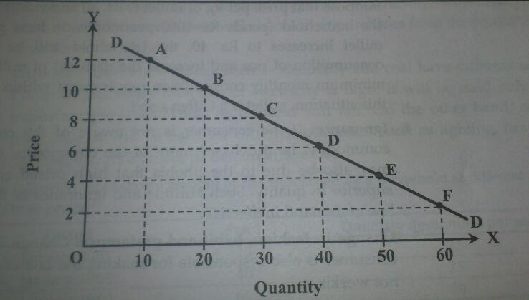
The above demand schedule shows an inverse relationship between the prices and the quantity demanded. At price of Rs 12 per unit, the consumer's purchase 10 units of the commodity. When the price falls to Rs 10 per unit, the consumers purchase increases 20 units of commodity. Similarly, when the price falls to Rs 2 per unit, the quantity demanded by him increases to 60 units.
Demand curve
A demand curve is a graphical presentation of the demand schedule. A demand curve is obtained by plotting a demand schedule into the graph. It is shown in the below figure.

Slide 43
In the figure, price is measured on Y axis and quantity on X axis. By plotting 10 units of a commodity at price Rs 12 per unit, we get point A. likewise by plotting 20 units of the commodity at price Rs 10 per unit, we get point B. similarly, points C, D and E are obtained. By joining these various points A, B, C D and E, we get a curve, DD, which is known as demand of curve. It slopes downwards from left to right i.e. negatively. The negative sloped of the demand curve shows the inverses relationship between the price of the commodity and its quantity demanded.

Slide 44
Determinants of demand
Price of the goods
Income of the customers
Price of the related goods i.e. substitute goods and complementary goods
Taste and preference of the customers
Advertisement
Size and composition of population
Consumer's expectation
The availability of credit
Climate and weather etc

Slide 45
Elasticity of Demand
According to the law of demand, there is inverse relationship between the price and the quantity demanded of a commodity. This law does not state the degree of change in demand due to change in price. To how much or to what extent the quantity demanded of a commodity will change because of a change in the price or income of the customer is provided by the concept of elasticity of demand..

Slide 46
In other words, the elasticity of demand shows the rate of change in demand in response to the change in the price. In simple words, the responsiveness of change in the quantity demanded due to change in its price is termed as elasticity of demand

Slide 47
Types of elasticity of demand
There are as many elasticity of demand as its determinants. The most important types of elasticity of demand are as follows.
Price elasticity of demand
Price elasticity of demand is defined as the responsiveness of change in quantity demanded of a commodity to the change in its price. In other words, the price elasticity of demand is defined as the ratio of percentage change in quantity demanded to the percentage change in price. Since, price and quantity demanded are inversely related; the coefficient of price elasticity of demand is negative. It can be expressed as

Slide 48
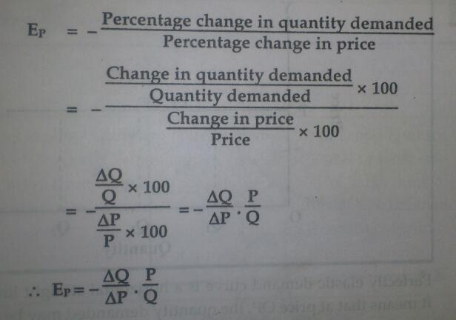

Slide 49
Where Q=initial quantity demanded
P=initial price
Ep coefficient of price elasticity of demand
Example: let us suppose that price of a commodity X decreases from Rs 10 per unit to Rs 8 per unit and quantity demanded of X increases from 50 unity to 60 units then find out price elasticity of demand.
Solution
Initial price (p) = Rs 10 initial Quantity Q = 50
New price (p1) =Rs 8 new quantity (Q1) =60
Change in price = P1-P= 8-10=-2
Change in quantity Q1-Q=60-50=10
Coefficient of price elasticity (Ep)=1
Interpretation: since, the coefficient of price elasticity of demand is 1 one percentage change in price results same percentage change in quantity demanded.

Slide 50
Types of degrees of price elasticity of demand
There are five types of price elasticity of demand. They are as follow:
Perfectly elastic demand (Ep= ~ )
Demand is said to be perfectly elastic if slight change in price leads to infinite change in the quantity demanded. Visibly, no change in price causes an infinite change in demand. Perfectly elastic demand is theoretical concept. It is hardly found in practice or real life.
Percentage change in demand
Ep=-----------------------------------------
Percentage change in price
It can be shown in the figure

Slide 51
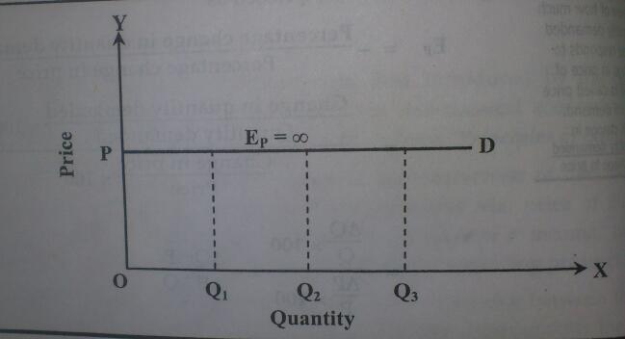
Perfectly elastic demand curve is a horizontal straight line parallel to the x axis. It means that at price OP, the quantity demanded may be OQ1or OQ2or OQ3.

Slide 52
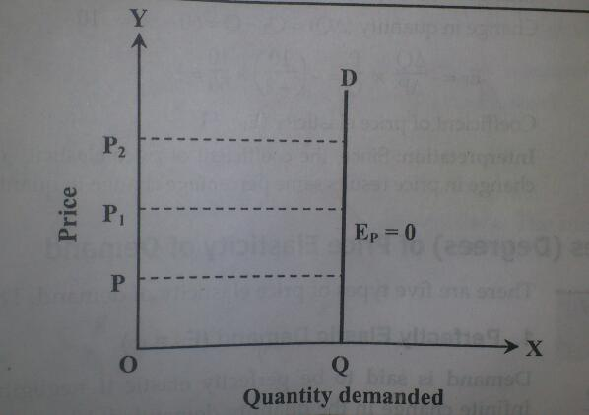
Perfectly inelastic demand (Ep=0)
When the demand for a commodity does not change with the change in its price, the demand is said to be perfectly inelastic demand. For example, medicine and salt have perfectly inelastic de 0
Ep=----------------------------------------
Any amount
It is shown in the figure
In the figure demand curve becomes vertical straight line or parallel to the Y axis. Even at the different prices OP or OP1or OP2, the quantity demanded is OQ. Example: Life-saving drugs like insulin for diabetics. Even if the price rises, patients still buy the same amount because they need it to survive.
Notes:
In the figure demand curve becomes vertical straight line or parallel to the Y axis. Even at the different prices OP or OP1or OP2, the quantity demanded is OQ.

Slide 53
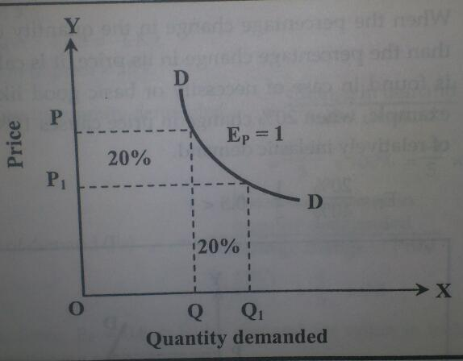
Unitary elastic demand (Ep=1)
When the percentage change in the quantity demanded is equal to the percentage change in price, the demand for a commodity is said to be unitary elastic demanded. For example, if a 20% change in price causes 20% change in demand, it is the case of unitary elastic demand.
Ep = 20%/ 20%= 1
In figure :The curve DD represents unitary elastic demand. When the price falls from OP to OP1, the quantity demand increases from OQto OQ1, ie the percentage change in price is equal to the percentage change in demand. Examples of goods with unitary elastic demand include household appliances, basic electronics, and mid-range branded clothing.

Slide 54
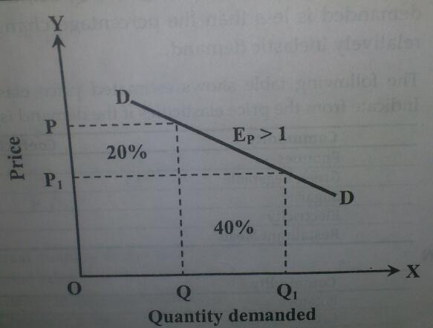
Relatively elastic demand (Ep>1)
When the percentage change in the quality demanded for a commodity is more than percentage change in its price, it is called relatively elastic demand. Such kind of elasticity of demand is found in case of luxury goods like LED television, refrigerator, car etc. If 20% change in price results 40 % change in quantity demanded, it is the case of relatively elastic demand.
Ep = 40%/20% = 2 >1
The above example can be shown in the figure
The demand curve DD represents relatively elastic demand because it is flatter. Therefore, the increase in demand is more than the fall in price. When price falls from OP to OP1 , the quantity demanded increase from OQ to OQ1, ie the percentage change in quantity demanded is more than the percentage change in price.

Slide 55
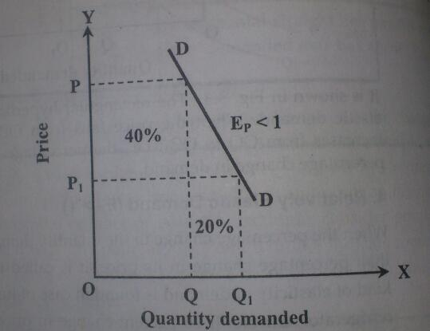
Relatively inelastic demand (Ep <1)
When the percentage change in the quantity demanded of a commodity is less than the percentage change in its price, it is called relatively inelastic demand. It is found in case of necessity or basic good like rice, vegetable, clothes, etc. for example, when 20% change in price causes 10% change in demand, it is the case of relatively inelastic demand.
Ep = 10%/20% = 0.5 <1
In the figure, demand curve DD is steeper. It means that the fall in price is more than the increases in demand. When price falls from op to op1, the quantity demanded increases oq to oq1 ie, the percentage change in the quality demanded is less than the percentage change in price. Therefore, it is the case of relatively inelastic demand.

Slide 56
The following table shows estimated price elastic of for selected commodities. Indicate from the price elastic if the demand is elastic or inelastic.
Commodity | Coefficient of price elasticity of demand | Type of demand
Potatoes | 0.31 | Inelastic
Green vegetable | 0.42 | Inelastic
Sugar | 0.33 | Inelastic
Electricity goods | 1.21 | Elastic
Restaurant meals | 2.27 | Elastic

Slide 57
Example: Calculate the price elasticity of demand and interpret the result when 25% increase price of potato results to decrease in quantity demanded from 5kg to 4 kg
Solution:
Initial demand (Q)= 5 k g
New demand = 4 kg
Change in demand = 4-5= -1 kg
Percentage change in price=-25%
Percentage change in quantity demanded = change in demand / initial demand x 100
= (4-5)/5 x 100% = -1/5 x100 = -20%
= (-20%)/25% = 0.8
Interpretation: since, Ep = 0.8<1, the demand for potato is inelastic. Therefore, it indicates that is necessity goods

Slide 58
Income elasticity of demand (Ey)
Income elasticity of demand is defined as the degree of responsiveness of demand for goods to the change in the income of the consumer. In other words, income elasticity of demand is the ratio of the percentage change in demand for a commodity to the percentage change in income .thus

Slide 59
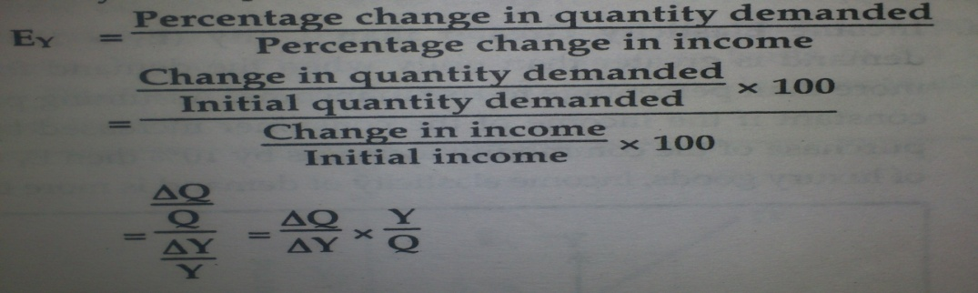
Where, Q = initial quantity
Y= initial income
Ey = income elasticity
Q = change in quantity
Y = change in income

Slide 60
The income elasticity may be positive negative or zero depending upon the nature of a commodity. As a rise in income leads to an increase in demand for a commodity, the income elasticity is positive. A commodity, which has positive income elasticity, is normal goods

Slide 61
.On the other hand, when a rise in income leads to a decrease in demand for a commodity, its income elasticity is negative. Such a commodity is called inferior good. If the quantity of a commodity purchased remains unchanged even at the change in income, the income elasticity of demand is zero.

Slide 62
Example, when consumer's income rises from Rs 100 to Rs 102, his demand for goods X increases from 25 units per week to 30 units per week. Then find out income elasticity of demand for goods X
Solution
Initial income Y= Rs 100
New income Y1= 102
Initial demand for goods Q= 25units
New demand for goods Q1= 30units
Change in income Y=Y1-Y=102-100=Rs 2
Change in demand Q= Q1-Q = 30-25 = 5 units
Ey = delta Q/ delta Y x Y/Q
= 5/2x100/25 = 10
Interpretation: since Ey=10. It means that one percent change in income results 10 percent increases in demand and vice versa. It is the case of normal goods.

Slide 63
Types of income elasticity
Income elasticity of demand can be divided into following three types
Positive income elasticity of demand (Ey>0)
If increase in income lends to increase in demand for a commodity and decrease in income leads to decrease in demand for a commodity, it is called positive income elasticity of demand. The commodity, which has positive income elasticity, is called normal goods. Positive income elasticity can be divided into three types.

Slide 64
Income elasticity greater than unity (Ey>1)
The income elasticity of demand is greater than unity when the demand for a commodity increased more than percentage to rise in income. assuming prices of all other goods as constant if the income of the consumer increased by 5% and as a result his purchase of the commodity increases by 10% then Ey=10%/5%=2>1. In case of luxury goods, income elasticity of demand is more than unity.

Slide 65
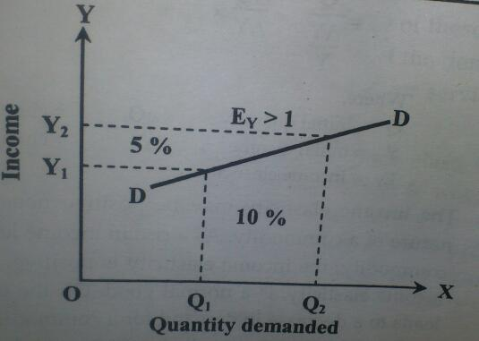
In the figure, the demand curve DD shows a positive and elastic income demand. When the customers income increases by 5% from OY1 to OY2 the quantity demand increased by 10% from OQ1to OQ2.

Slide 66
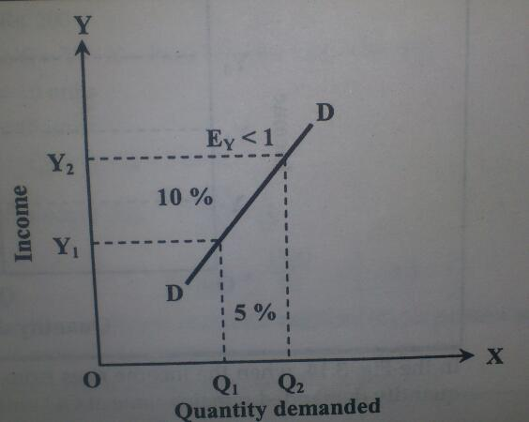
In the figure, the demand curve DD shows a positive and elastic income demand. When the customers income increases by 10% from OY1 to OY2 the quantity demand increased by 5% from OQ1to OQ2.

Slide 67
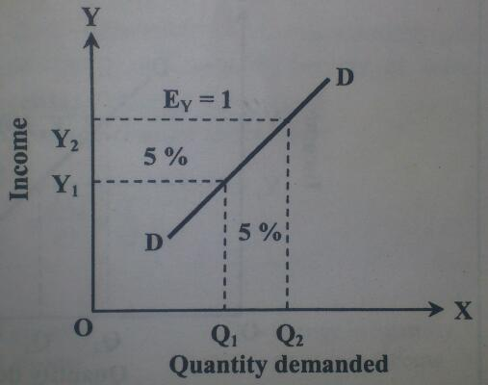
Income elasticity equal to unity (Ey=1)
Income elasticity is unity when the demand for a commodity increases in the same proportion as the rise in income. For example, 5% rise in income leads to 5% increase in demand Ey=5%/5%=1. In case of comfortable goods, income elasticity of demand is equal to unity.
In the figure, the demand curve DD shows the unitary elastic demand. in the figure, consumers income increases by 5% from oy1 to oy2exactly equals to increases in demand by 5% from oq1 to oq2.

Slide 68
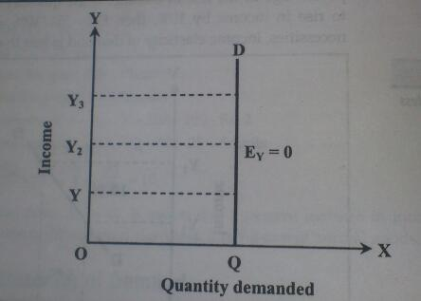
Zero income elasticity (EY=0)
If with the rise in income, the quantity demanded remains unchanged, the income elasticity is said to be zero. if with 5% rise in income, there is no change in the quantity demanded, then EY=0/5=0 in case of neutral goods like salt, income elasticity of demand is zero.
In the figure, when the income rises from OY1TO OY2 or OY3 respectively, the quantity demanded remains same at OQ units.

Slide 69
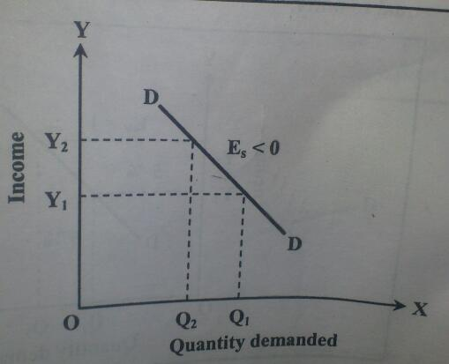
Negative income elasticity<0 in the case of inferior goods, the income elasticity of demand is negative. When the consumers reduce his demand with the rise in income, the income elasticity of demand is said to be negative. If 5% rise in income leads to 2% reduction in demand ey = -2%/5% <0
In case of inferior goods, income elasticity of demand is negative. (mansuli and basmati rice)
In the figure DD is a demand curve for inferior goods. When the income increase from oy1 to oy2, the quantity demand decreases from oq1 to oq2

Slide 70
cross elasticity of demand Ec
If the change of the price of one commodity brings the change in demand of other commodity, then it is called cross elasticity of demand. In case of related goods (substitute and complementary) such elasticity arises. The cross elasticity of demand is defined as the percentage change in the quantity demanded of good X resulting from a percentage change in the price 0 Y. in the other words, the ratio of percentage change in the quantity demand of good X to a given percentage changes in the price of good Y. the cross elastic of demand between good X and Y is given below.

Slide 71
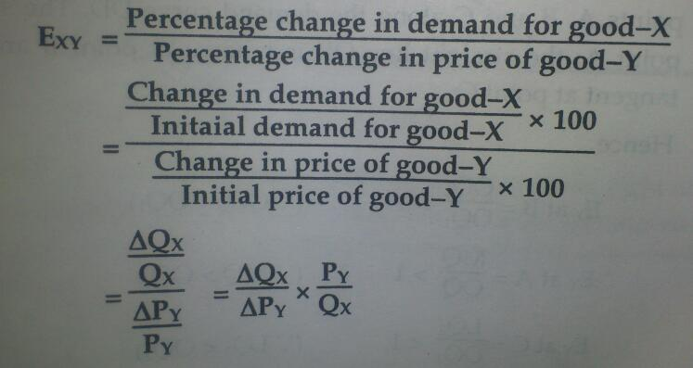
Where,
EXY = cross elasticity of demand
Py = price of good Y
Qx = quantity of good X,
Delta Py = change in the price of good Y
Delta Qx= change in the demand good X
If X and Y are substitutes, Exy is positive. On the other hand, if X and Y are complements, Exy will be negative and when goods are not related, Exy = 0

Slide 72
Price of coffee in RS/cup | Demand for tea in cup
10 | 40
15 | 60
Let tea and coffee (substitute goods) are X and Y goods respectively

Slide 73
Types of cross elasticity of demand
Positive cross elasticity Ec=+ve or (Exy >0)
When the quantity demand of a commodity and price of related commodity change into same direction, the cross elasticity of demand is positive. In the case of subsi9tute goods, the cross elastic of demand is positive.
For example, if the price of tea rises, it will lead to increase in the demand for coffee. Similarly, a fall in price of tea will cause a decrease in the demand for coffee. Hence, tea and coffee are substitute goods.

Slide 74
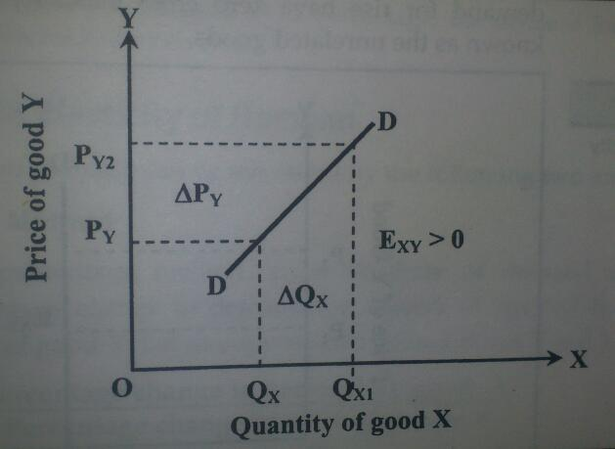
In the figure, the upward sloping demand curve DD shows positive cross elasticity of demand. Here, the increase in price of commodity Y ie tea leads to increase in demand for commodity X ie coffee. It is because of people substitute tea for coffee due to high price of tea when price of coffee is remaining constant.

Slide 75
Negative cross elasticity Ec=-ve( Exy<0)
When demand for a commodity and price of related commodity change into opposite direction, the cross elasticity of demand is negative. In the case of complementary goods, cross elasticity of demand is negative. For example, if the price of car falls, assuming the price of petrol remains constant, the demand for car and petrol both increase because both are used jointly used. It means that car and petrol are complementary goods.

Slide 76
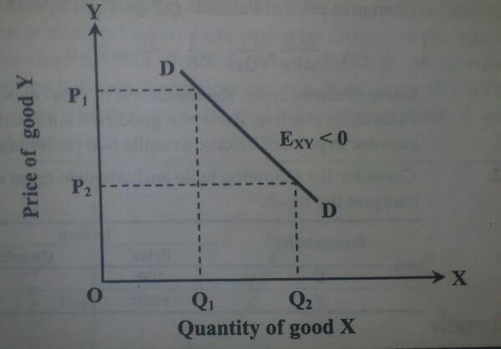
In the figure, the downward sloping demand curve shows the negative relationship between demand for petrol and price of car. When the price of car falls from OP1 to OP2 the demand for petrol will increase from OQ1 to OQ2. Therefore, car and petrol are complementary goods.

Slide 77
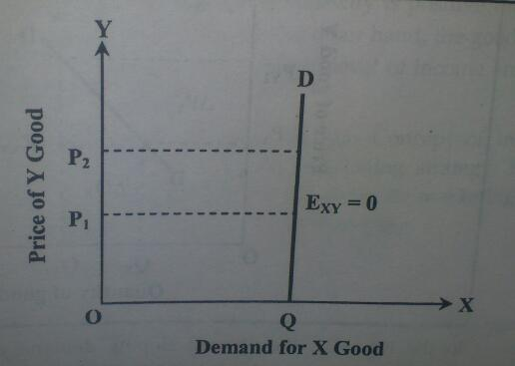
Zero cross elasticity Ec=0
When the change in price of one good has no effect on the demand for another good, the cross elasticity of demand is zero. For example, price of car and demand for rise have zero cross elasticity of demand. Such goods are also known as unrelated goods.
In the figure, vertical straight demand curve DD shows the zero cross elasticity of demand. Here, increase in price of commodity Y watch does not have any efficient to the demand for commodity X sugar because these goods are non related with each other.

Slide 78
Example: calculate the cross elasticity between Samosa and Pakauda using following table
Commodity Before After Price quantity price quantity Samosa X 20 1 20 2 Pakauda Y 10 2 15 1
Solution
Initial demand for Samosa Qx = 1
Initial price of Pakauda Py = 10
Change in demand for Samosa delta Qx = Qx1 – Qx = 2-1 = 1
Change in price of Pakauda delta Py = Py1 – Py = 15- 10 = Rs 5
New demand for Samosa Qx1 = 2
New price of Pakauda Py1 = Rs 15
We have

Slide 79
1/5x10/1 = 2 >1
Interpretation: since, the coefficient of cross elasticity of demand between Samosa and Pakauda is positive, these two goods are substitutes. Moreover, Exy = 2, one percentage increase in price of Pakauda results two percentage increase in demand for Samosa.

Slide 80
Meaning of supply
Supply means the quantity of a commodity which its producer or seller is ready to offer for a sale at a given price and period of time.
Just as demand implies willingness and ability to pay, in the same manner the phrase ready to offer for sale in the definition of supply given above implies both willingness and ability to deliver the goods.
In general, more goods are offered for sale at higher price ie supply increases with the increase in price. Therefore, the relation between price and quaintly supplied is positive and direct.

Slide 81
Law of supply
The functional relationship between price and quantity supplied gives the law of supply. According to this law, other things remaining the same, the quantity supplied of a commodity is directly related to the price of the commodity. It means that when price rises, the quantity supplied increases, and when prices fall, the quantity supplied decreases. Other things mean the price of other commodities, the price of factors of production, the state of technology and the goals of producers. All these factors are assumed to be constant. They are the assumptions of the way of supply. It can be explained by the help of supply schedule and supply curve.
Supply schedule
A supply schedule is a tubular presentation of the various quantities of a commodity offered for sale at various prices at given period of time. A hypothetical supply schedule is given below.

Slide 82
Price of apple per unit | Quantity of supply in units
2 | 5
4 | 10
6 | 15
8 | 20
10 | 25

Slide 83
The above table shows that at price Rs 2 per unit, the quantity supplied is 5 units. When the price of a commodity rises to Rs 4 per unit, 10 units of a commodity are supplied. Similarly, when the price is raised to Rs 8 per unit, 20 units of commodity are supplied. It can also be shown by the help of supply curve.
Supply curve
Supply curve is a graphical representation of supply schedule, indicating positive relationship between price of a commodity and its quantity supplied.

Slide 84
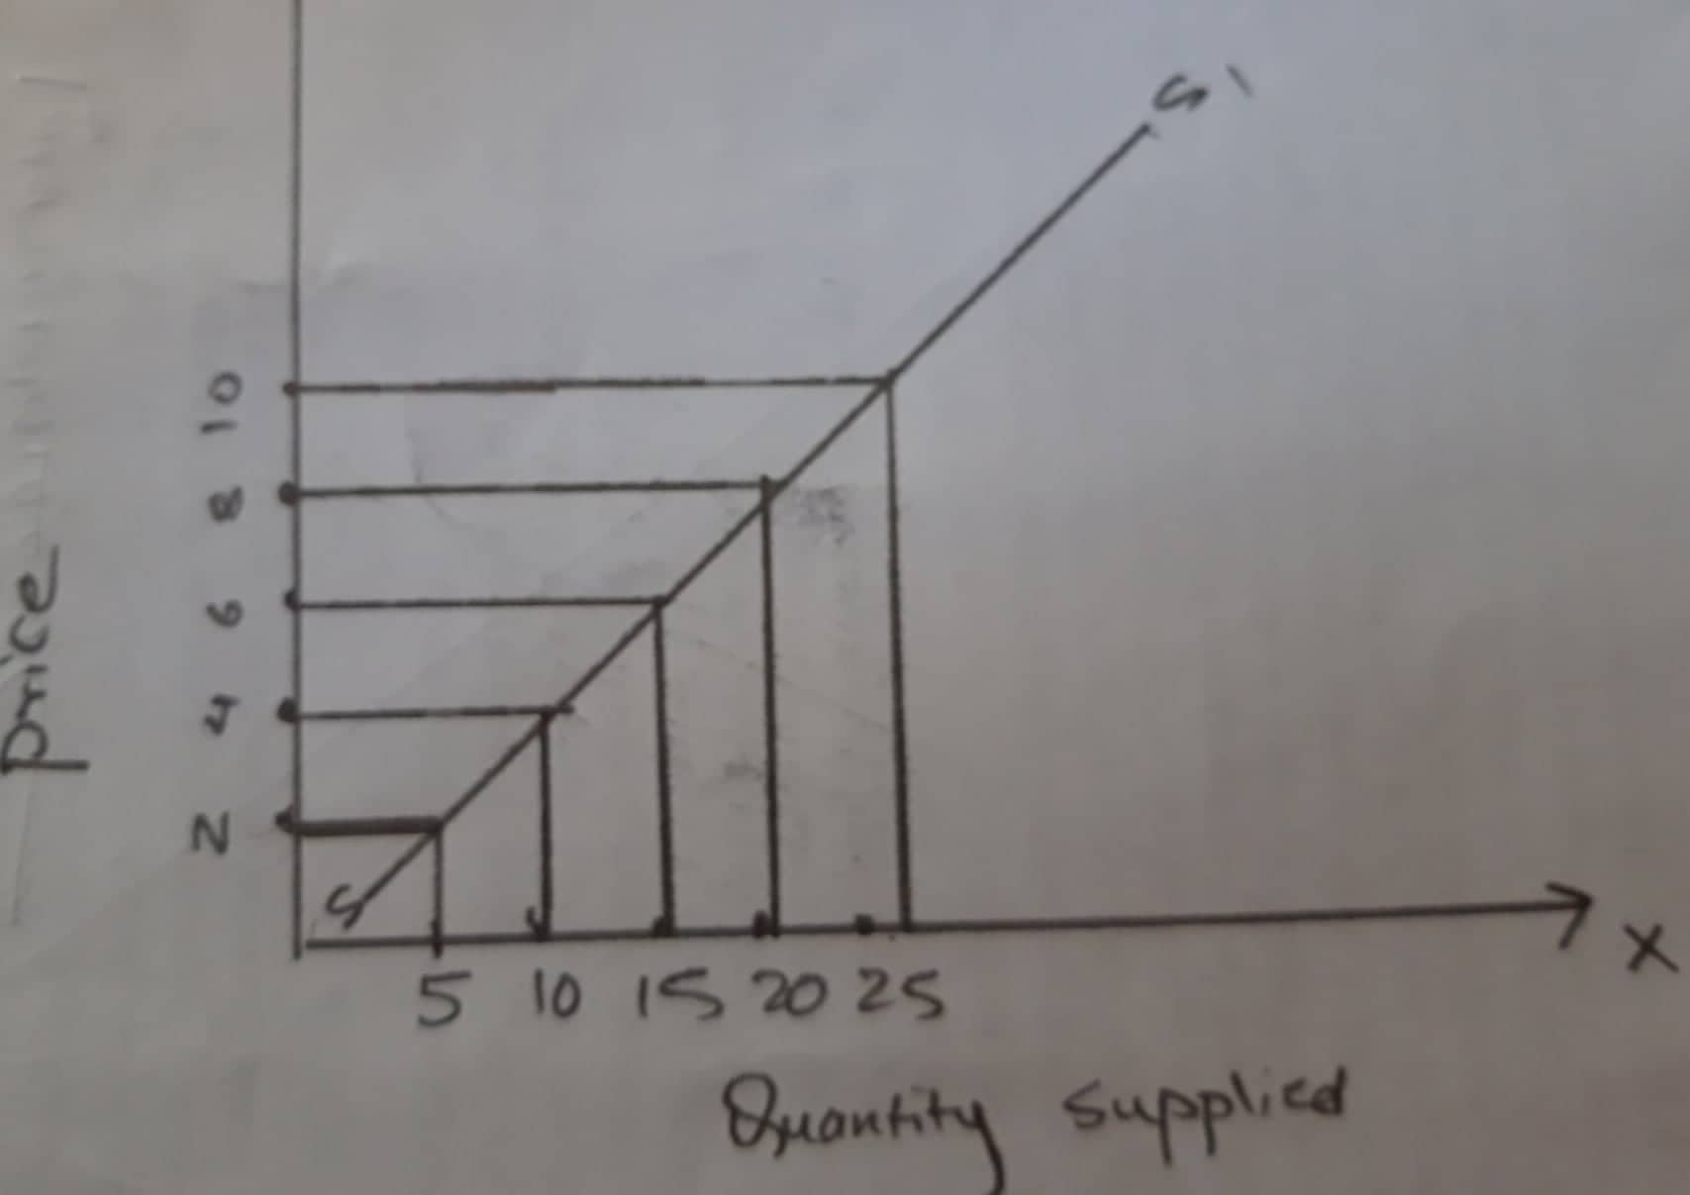

Slide 85
In the figure, when the price is Rs 2 per unit, the quantity supplied is 5 units. As the price rises to Rs 4 per unit, the quantity supplied increases to 10 units. Similarly, as the price increases toRs 8 per unit, the quantity supplied increases to 20 units. In the figure, points A, B, and D are obtained by the rice supply relation. By joining these points, we get a curve SS, which is known as supply curve. It is upward sloping. It means that there is positive relationship between price and quantity supplied.
Exceptions to the law of supply
Expected price
When price is expected to fall much, sellers sell more even at the lower price in order to clear their stocks. When price is expected to rise in future, sellers sell less even at high price in the present time.
Change in other factors
Change in habit, taste, fashion weather and national and international disturbances also affect the supply of a commodity.
Agricultural goods, the supply of agricultural goods more depends upon natural factors rather than price of the commodity. For example, natural disaster like flood reduces supply of paddy.
Perishable goods, sellers want to sell more units of perishable goods although their prices may be falling because the sellers cannot hold perishable goods.
Auction sale, when a firm wants to sell its old stock, it sells through auction sale. In the case of auction sale, seller's sale more goods at a reduced price. The motive behind such a sale is to clear off old stock.

Slide 86
"Demand creates its own supply.“
When people strongly want or need something (demand), this demand can motivate businesses, entrepreneurs, or creators to step up and create the product or service to meet that need—that is, it drives supply into existence.

Slide 87
"Demand creates its own supply" is a simplified way of describing how the desires and needs of consumers in a market can lead to the production and availability of goods and services to meet those demands. It suggests a relationship where the existence of demand is a primary driver for the creation of supply.
If people and businesses stop spending (low demand), production (supply) falls, leading to unemployment and recession.
Markets can fail to self-correct, requiring government intervention (e.g., stimulus spending).

Slide 88
Supply Creates Its Own Demand" – Say's Law Explained
The principle that "supply creates its own demand" is the foundation of Say’s Law (or Say’s Law of Markets), named after the 19th-century French economist Jean-Baptiste Say. It is a central idea in classical economics and contrasts sharply with Keynesian economics.

Slide 89
Core Idea of Say’s Law
Say argued that production (supply) is the source of demand. In other words:
When a good is produced, it generates income (wages, profits, rents) for workers and business owners.
This income is then spent on other goods and services, creating demand in the economy.
Thus, supply leads and drives demand.

Slide 90
Example of Say’s Law in Action
Imagine a simple economy with three producers:
A farmer (produces wheat)
A baker (produces bread)
A tailor (produces clothes)
The farmer sells wheat to the baker → earns money → spends it on clothes from the tailor.
The baker sells bread to the tailor → earns money → spends it on wheat from the farmer.
The tailor sells clothes to the farmer → earns money → spends it on bread from the baker.
Result:
Every act of supply (production) generates demand (spending) elsewhere.
No permanent unsold goods or unemployment exists because income circulates.

Slide 91
Say’s Law claims that production generates the purchasing power needed to buy goods, meaning economies should self-balance.

Slide 92
Meaning of utility
Utility is a term used to determine the worth or value of a good or service. More specifically, utility is the total satisfaction or benefit derived from consuming a good or service. The economic utility of a good or service is important to understand because it directly influences the demand, and therefore price, of that good or service. In practice, a consumer's utility is usually impossible to measure or quantify. However, some economists believe that they can indirectly estimate what is the utility of an economic good or service by employing various models.

Slide 93
Definition of 'Marginal Utility'
The additional satisfaction a consumer gains from consuming one more unit of a good or service. Marginal utility is an important economic concept because economists use it to determine how much of an item a consumer will buy. Positive marginal utility is when the consumption of an additional item increases the total utility. Negative marginal utility is when the consumption of an additional item decreases the total utility.

Slide 94
Law of diminishing marginal utility / cardinal utility approach
This concept law of diminishing marginal utility was initially developed by HH Gossen and popularized by famous neoclassical economist Alfred Marshall . According to marshal in the process of fulfilling human wants, when a consumer consumes more and more units of a commodity, the utility derived from each successive unit of the commodity goes on decreasing. Hence, the relationship between quantity consumed and utility derived from each successive unit is called marginal utility. According to marshal the additional benefit which a person derives from an increase of his stock of a thing diminishes with the growth of the stock that he already has.
this law is based and explained under certain conditions or assumptions, such as, utility is measurable, consumers take and preference much be unchanged, suitable and similar units of commodity, rational customers and continuous consumption etc. it can be explained more systematically with the help of a numerical example and figure. Let us consider the following table

Slide 95
Unit of consumption | Total utility TU | Marginal utility MU
1 | 6 | 6
2 | 10 | 4
3 | 12 | 2
4 | 12 | 0
5 | 10 | -2

Slide 96
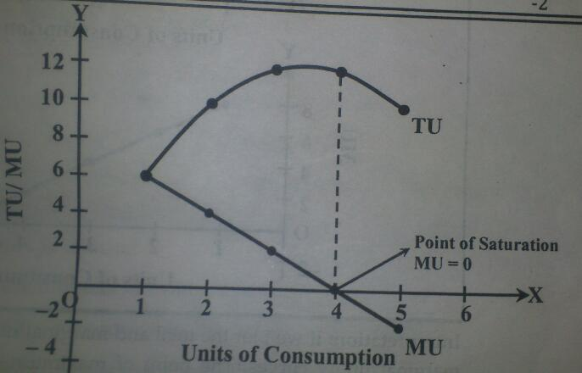
In the figure, TU represents total utility and MU represents marginal utility. Initially, TU increase at a diminishing rate with the increase in consumption. At the same time, mu declines with the increase in consumption. When the consumer consumes four units of the commodity, TU is the maximum and mu became zero. If he further increases his consumption then marginal utility becomes negative which is shown by the portion of the curve lying below the X axis. When marginal utility is negative, total utility is declining. So total utility is curve initially slopes upward and after reaching at its maximum point starts to decline whereas marginal utility curve is downward Sloping and may become zero or negative.

Slide 97
Criticisms/ limitations of law of diminishing marginal utility
The measurement of utility is not practical, the law of diminishing marginal utility believes that utility can be measured in terms of numbers which is impossible because utility is a subjective and cannot be measured objectively. So it is practically meaningless.
Diminishing marginal utility is not valid for all type of goods; there are some exceptional goods which do not obey the law of diminishing marginal utility. The hobby of collection stamps, coins, care goods it, may have increasing marginal utility. Likewise, listening music earring money, drinking wine etc may also have increasing marginal utility.
Utilities are dependent. One of the strong assumption of this theory is utilities remain independent. But in practical life utilities remain dependent to each other. If various goods are consumed at the same time, consumption of one good can affect the level of satisfaction obtained by the consumption of other goods.
No classification of goods, this utility analysis is not able to classify various types of goods like normal, inferior, superior etc
Less work more assumption, this theory assumes more and explains less. Most of the assumptions are unrealistic which are criticized strongly in various grounds.

Slide 98
Principles of economics
1. People must make choices because resources are scarce: every one of us have to make choices about what to do and what not to do. Individual choice is the basic of economics. The reason choices must be made is that resources are scare. A resource is anything that can be used to produce something else. List of the economy’s resources commonly include land, labour, capital, materials and machinery. A resource is scares when there is not enough of the resource available to satisfy all the ways a society wants to use it.
There are many scarce resources. These include natural resources that come from the physical environment, such as minerals, wood, and petroleum. There is also a limited quantity of human resources, such as labour, skill and intelligence. And in a growing world economy with a rapidly increasing human population, even clean air and water have become scare resources. Just as individuals must make choices, the scarcity of resources means that society as a whole must make choices.

Slide 99
2. The true cost of something is its opportunity cost: because people must choose among limited alternative, each choice (trade off) involves opportunity cost. The opportunity cost of an item is what people must sacrifice to get that item. In making any decision, decision makers should be aware of the opportunity costs that go or come with each possible action. Decision makers need to compare the cost of alternative course of action.
To get one thing, we usually have to give up something else

Slide 100
3. Rational people think at the margin: a very common assumption of economics is that people are rational. rational people are those who have the ability to reason or think before making decision. These people systematically and intentionally do the best they can to achieve their objective, given the available opportunities. In making decision on questions involving how much (for example how much to spend on some goods, how much to produce, and so on) rational people often make comparison of marginal benefits and marginal cost. The term margin means doing a bit more or a bit less (by one unit less or add)

Slide 101
4. People usually respond to incentives: the study of how people should make decisions is also a good way to understand actual behavior. Individuals normally respond to incentives, utilizing opportunities to make themselves better off. An incentive is stimulation (such as the chance of a reward or punishment) that encourages people to work. Because rational people make decisions by comparing costs and benefits, they respond to incentives.
Incentives play a central role in the study of economics. For instance, let us consider the effect of price change in the market, a higher price in a market provides an incentive for buyers to consume less and an incentive for sellers to produce more. The effect of prices on the behavior of consumers and producers is crucial in understanding how a market economy allocates scare resources.

Slide 102
5. There are gains form trade: individuals interact through trade because there are gains form trade. By engaging in the trade of goods and services with one another, the members of an economy can all be made better off. Specialization (each person specializes in the task he or she is good at) is the source of gains from trade. Trading partners gain additional output through specialization of production and exchange of goods and services.

Slide 103
6. Market moves towards equilibrium: because people respond to incentives, markets move toward equilibrium. Equilibrium is a situation in which no individual can make himself or herself better off doing a different action. The concept of equilibrium is really helpful in understanding economic interactions because it provides a way of penetrating the sometimes-complex information of those interactions. Equilibrium is the state in which market supply and demand balance each other, and as a result prices become stable. Generally, an over-supply of goods or services causes prices to go down, which results in higher demand—while an under-supply or shortage causes prices to go up resulting in less demand. What we need to know is that whenever there is a change in price or change in demand or supply or in both demand and supply, the situation will ultimately move to an equilibrium. The fact that markets move toward equilibrium is why we can depend on them to work in a predictable way.

Slide 104
7. Resources should be used efficiently to achieve society’s goal: this principle gives us a standard to use in evaluating an economy’s performance. It helps us to know how well a market economy is doing. As resources are scarce, society should use them as efficiently as possible to achieve society’s goals. Because people usually exploit gains from trade, markets, markets generally lead to efficiency. Efficiency means that society is getting the maximum benefits from its scare resources. Economy is efficient if it fully utilizes all options to make some people better off without making other people worse off. In other words, an economy’s resources are used efficiently when they are utilized in a way that has fully taken advantage of all chances to make everyone better off.

Slide 105
8. Markets usually lead to efficiency: because people habitually exploit gains from trade, markets usually lead to efficiency. Markets are usually a good way to organize economic activity. Market economy allocates resources through the decentralized decisions of many firms and households as they interact in markets for goods and services. There are a number of reasons on why markets are usually very good at making sure that resources are used properly. The most basic reason is that in a market economy, in which individuals are free to choose what to consume and what to produce, people generally take opportunities for mutual benefit, that is, gains form trade.

Slide 106
9. When markets do not achieve efficiency, government intervention can improve society’s welfare: markets usually result in efficiency but with a few clearly described expectations. Market failure occurs when resources are misallocated or allocated inefficiently. In other words, when the assumptions of a perfect competition market do not hold, the conclusion that free and unregulated markets will produce an efficient allocation of resources ends. The result is waste or lost surplus. When markets fail and do not achieve efficiency, government intervention can improve society’s welfare. Widely sources of market failure include, a. imperfect competition, b, the existence of public goods, c, the presence of external costs and benefits and d, imperfect information.

Slide 107
10. One person’s spending is another person income: because people in a market economy generate income by selling things, including their own labour, one person’s spending is another person’s income. If some group in the economy decides, for whatever cause, to spend more, the income of other groups will rise. Instead, if some group decides to spend less, the income of other groups will fail. As a result, changes in spending behavior of individuals can spread throughout the economy. Changing in the spending behavior of people have echoing of effects that spread all over the economy.

Slide 108
Meaning of engineering economics
It is one of the most practical subject matters in the engineering curriculum, but it is always a challenging and an ever-changing discipline. It deals with the concepts and technical analysis which is useful in evaluating the projects. The role of engineering economic is to assess the appropriateness of a given project, estimate its value, and justify it from and engineering standpoint. It involves the financial and economic evaluation of manufacturing projects.

Slide 109
In short, economic decision making for engineering systems is called engineering economics. The objective of engineering economic is to explain and develop the commercial and financial knowledge of engineers. Engineers are the people who are familiar with all the technicalities of machinery and production, therefore they are the best judges of the useful lives of assets and they also have the technical knowledge to calculate the number of units a proposed plant would produce when operational.

Slide 110
Engineering economics is the field of those activities which are concerned with the systematic evaluation of the costs and benefits of proposed technical and business projects design and analysis. It is concerned with the systematic evaluation of the benefits and costs of projects involving engineering design and analysis. Thus, engineering economy requires the application of engineering design and analysis principles to provide goods and services that satisfy the consumer at an affordable cost.

Slide 111
It is essential that every engineering proposal be evaluated in terms of cost and worth before they are undertaken and economic feasibility is an essential for every successful engineering application. Engineering economic requires the application of technical and economic analysis with the goal of deciding best meets technical performance criteria and uses scare resources in an effective way.

Slide 112
Engineering economic is the application of economic techniques to the evaluation of design and engineering alternatives. The role of engineering economic is to assess the appropriateness of a given project, estimate its value and justify it from and engineering standpoint.
Engineering economics deals with the methods that enable one to take economic decision toward minimizing the cost or maximizing benefits to business organization.

Slide 113
Study and important usages of engineering economic
The study of engineering economy draws upon knowledge of engineering and economics to address problems of allocating scare resources. It is concerned with the systematic evaluation of the costs and benefits of proposed technical and business projects. The techniques and models of engineering economy assist people in making decision. Since decision affects what will be done and the time frame of engineering economy in primarily the future. Therefore, the use of engineering economic analysis may be best estimates of what is expected to occur. These estimates often involve following three essentials elements, cash flow, time and interest rate.

Slide 114
The principles and methodologies of engineering economy have wide application in engineering design and technical as well as general management. Similarly, it is an integral part of daily management and operation of private companies and corporations, government agencies and nonprofit organizations. In the operation of capital funds on any project, engineers and managers can use the study of engineering economy to as set decision making situation from the following ground.
a. Selecting, between alternative designs for a component, machine, structure, system, product or service during the engineering design process.
b. estimating and analyzing the economic consequences of improvements in a factory operation
c. Selection among proposed projects within the annual capital budget limit.
d. Analyzing whether the equipment is should replace or not.
e. Choosing between asset lease or purchase options to a product.

Slide 115
Hence, the use of engineering economics study involves technical and economic analysis with a decision-making objective.
Principles of engineering economics
The followings are some important principles of engineering economics

Slide 116
1. Develop the alternatives (remember quality derives from quantity)
The feasible alternatives need to be identified and then defined for subsequent analysis. A decision involves making a choice among two or more alternatives. If there is only one alternative, no choice is required. Developing and defining the feasible alternatives for evolution is important because of the resulting impact on the quality of the decision on the quality of decision. Engineers and managers should place a high priority on this responsibility.
Before making a decision, identify and analyze multiple feasible alternatives.
Example: Comparing different materials, designs, or technologies for a construction project.

Slide 117
2. Focus on the differences,
the expected differences in future outcomes among the alternatives are relevant to their comparison and should be considered in the decision making. If all prospective outcomes of the feasible alternatives are exactly same, we would be indifferent among the alternatives and could make a decision using random selection. Be very neutral and impartial between the alternatives.
Only the differences (incremental costs and benefits) between alternatives are relevant for decision-making.
Example: If two machines have the same maintenance cost, focus only on their differing purchase prices and efficiencies.

Slide 118
3. Use a consistent view point, to determine prospective outcomes of the feasible alternatives, the viewpoint should be consistently developed and defined. It is important that the viewpoint for the particular decision is defined and then used consistently in the description, analysis and comparison of the alternatives. What is your viewpoint? be consistent
A consistent viewpoint refers to maintaining a steady and unchanging perspective or opinion on a particular issue over time.
The Principle of Using a Consistent Viewpoint in engineering economics ensures that all alternatives are evaluated from the same perspective to avoid unfair or incomparable results.

Slide 119
Use of common unit of measure,
common unit of measurement should follow to list prospective outcomes of the feasible alternatives which will make easier the analysis and comparison. For economic consequences a monetary unit is the common measure. If expected consequences cannot translate or estimate by using monetary unit, you should describe these consequences clearly.
Compare alternatives using a common monetary unit (e.g., dollars, euros) to ensure objective evaluation.

Slide 120
Consider all relevant criteria;
selection of a preferred alternative requires the use of all relevant criteria. In engineering economic analysis, the primary criterion relates to provide maximum monetary return to the owners. But other objectives like social, cultural, environmental justice etc. should become the basis for additional criteria in the decision-making process. Try to underpin (support) your decision from all perspectives.

Slide 121
Make uncertainly explicit
uncertainty is inherent in projecting or estimation magnitude and impact of future outcomes of the feasible alternatives and should be recognized in their analysis. Thus, dealing with uncertainty is an important aspect of engineering economic analysis.
"Uncertainty explicit" refers to situations where uncertainty is openly acknowledged and clearly communicated. It involves being transparent about the unknowns or ambiguities in a situation, decision, or piece of information. In fields like science, engineering, business, or decision-making, making uncertainty explicit allows stakeholders to understand the limitations of predictions, assessments, or models.
Acknowledge and account for risks, variability, and unknowns in economic analyses.
Notes:
Explicit is like clear,

Slide 122
7 Revisit your decision
Improve decision results from an adaptive process, due to this the projected outcomes of the selected alternative and actual results achieved should be subsequently compared. Organizational discipline is needed to ensure that post evaluations of implemented decision are routinely.
Economic decisions should be reviewed as new information becomes available.
Example: Re-evaluating a project’s feasibility if market conditions or regulations change.

Slide 123
More important
accomplished and the results used to future decision making.
More importance
Equipment and process selection
Equipment replacement
New product development and production expansion
Cost reduction
Capital budget allocation
Service improvement
New project evaluation etc

Slide 124
Role of Engineers in decision making / Engineering economic is all about decision making
Decision making is the process of selecting best alternatives among available alternatives. An engineering economist draws upon the accumulated knowledge of engineering and economics to identify alternative use of limited resources and to select the preferred option in the course of action. It is devoted to problem solving and decision making at all levels.
A decision is simply the selection of best one from two or more options in course of action whether it takes place in construction or production, service or manufacturing industries, private or public agencies. The major decisions have economic overtones that make the subject of engineering economy more challenging and rewarding at present time.

Slide 125
The use of engineering economics analysis may be the best estimates of what is expected to occur in future. These estimates often involve following three elements: cash flows, time frame and interest rate. Engineering economics quantifies the benefits and cost associated with engineering projects to determine capital investment. The decisions are made by the engineers to choose one project over another and decisions often reflect to choice of how to best use or invest capital funds.

Slide 126
Hence, the techniques and methodology of engineering economy can assist engineers in decision making process from the following grounds.
i. Understand the problem
ii. Define objective
iii. Collect relevant information
iv. Develop feasible alternatives
v. Identify the criteria for decision making
vi. Select the best alternative
vii. Evaluate each alternative
viii. Effective implementation and so on

Slide 127
In decision making process, the role of engineers may also be different situations like
i. Equipment and process selection
ii. Equipment replacement
iii. New product and production expansion
iv. Cost reduction
v. Capital budget allocation
vi. Service improvement
vii. Project evaluation
Hence, engineers generally attract to practical problems with appropriate solution in decision making process.

Slide 128
why an engineer need to study engineering economics?
1. Decision-Making Under Constraints
Engineers often choose between multiple solutions. Engineering economics helps them evaluate (cost vs. benefit, short-term vs. long-term) and pick the most economically efficient option.
Engineers must evaluate whether a project is economically viable by comparing costs (materials, labor, maintenance) with benefits (revenue, efficiency, lifespan).
Example: Choosing between two construction materials—cheaper upfront vs. longer-lasting but more expensive.

Slide 129
2. Resource Optimization
Limited budgets require efficient allocation of resources (men, money, materials and machinery)
Engineering economics helps in selecting the most cost-effective solution without compromising quality.

Slide 130
3. Project Feasibility & Justification
Before approval, engineers must prove that a project is financially feasible.
Techniques like Net Present Value (NPV), Internal Rate of Return (IRR), and Payback Period help assess profitability.

Slide 131
4, Aligning Engineering with Business Goals
Engineering doesn't happen in a vacuum. It happens in companies that need to:
Stay profitable
Beat competitors
Deliver value

